Slide 1
MTP
Fluid simulation using Deep Learning Methods
Team
Mentor : Dr. Gaurav Bhutani
Members
Piyush Bafna B17020
Shashi Kumar Fagna B17141
Toshendra Rustagi B17147

Slide 2
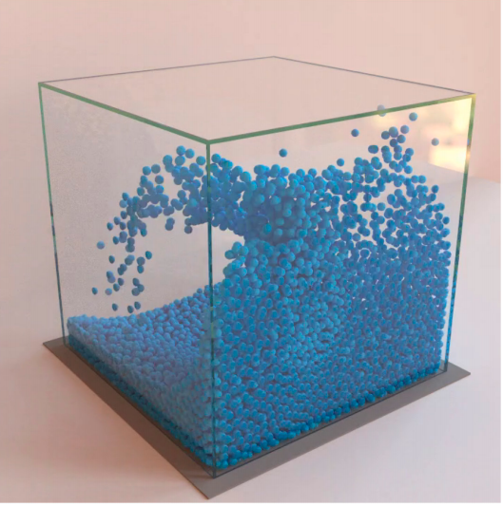
Problem Understanding
Problem statement : To develop a Deep Learning Model for Fluid Simulation using Data generated from physics fluid simulators.
Aim of the project : To make a improvised deep learning model that is robust to hurdles and can be used for a variety of fluids and deformable materials under challenging domains.
Reference : https://arxiv.org/pdf/2002.09405.pdf

Slide 3
GNS Framework
Graph Network-based simulator framework is single deep learning architecture. This framework can be used to learn to simulate complex physics problems. It is found that GNS can learn to accurately simulate a wide range of physical systems in which fluids, rigid solids, and deformable materials interact with one another.
The framework imposes strong inductive biases, where rich physical states are represented by graphs of interacting particles, and complex dynamics are approximated by learned message-passing among nodes.
Reference : https://arxiv.org/pdf/2002.09405.pdf

Slide 4
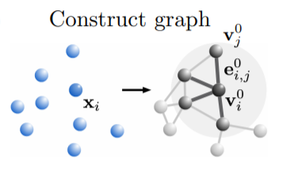
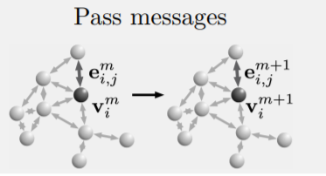
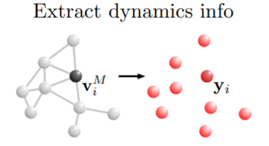
Working of GNS Framework
Reference : https://arxiv.org/pdf/2002.09405.pdf

Slide 5
Planning
We have divided the project into 5 sub-task:
We are done with understanding and replicating the previous work. Currently, we are brainstorming the new model/architecture.
Literature study & replication of previous Deep Learning Model. | Sept - Oct 2020
Brainstorming new model/architecture. | Nov 2020
Implementing & Pipelining new model/architecture. | Dec 2020 -Jan 2021
Fine tuning the hyperparameters of new Deep Learning Model. | Feb - April 2021
Visualizing the final result from the new model. | May 2021

Slide 6
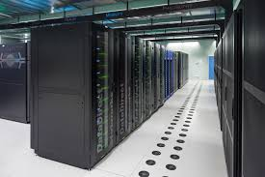
Progress So Far
Done thorough understanding of previous work and replicated it to match the results.
Brainstorming with mentor and previous team.
Literature survey on the state-of-the-art technique for fluid simulation.
Requested for High Performance Cluster.

Slide 7
Thank You

